Slide 1




Combustible Gas Storage Warehouse Monitoring System
IoT-Based Real-Time Monitoring and Safety Control
Project by;
COHNDSE232F-058 – PATT PERERA
COHNDSE232F-059 – NHI PERERA
COHNDSE232F-061 – LM NAVARATNA
COHNDSE232F-062 – SJ RANATHUNGA

Slide 2
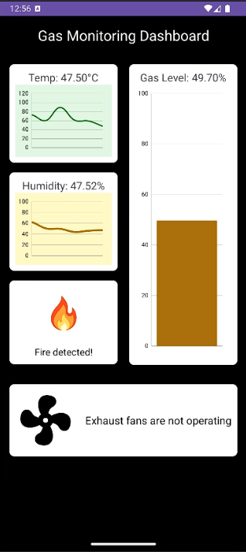
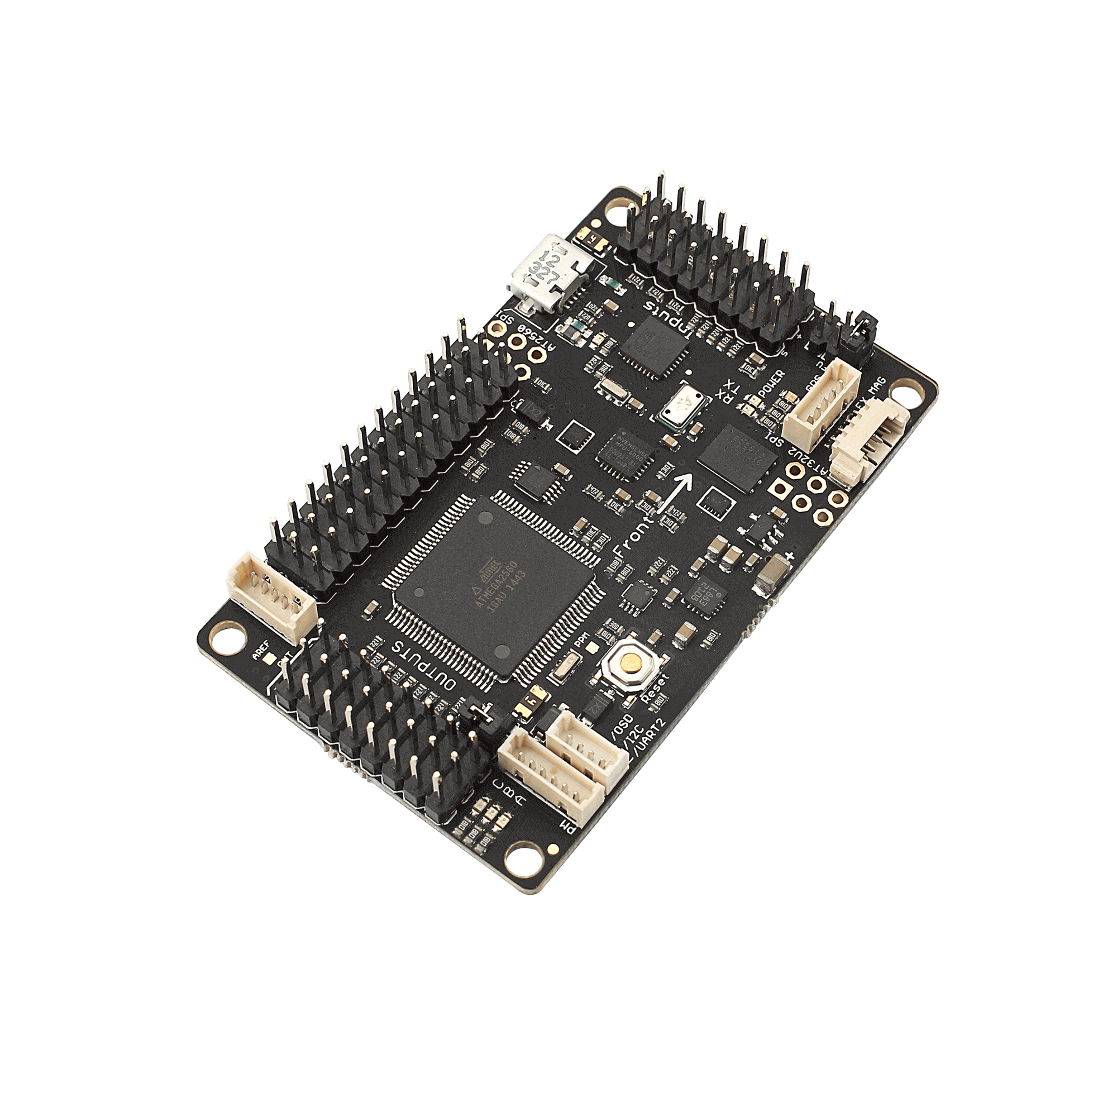

Introduction
Purpose: Enhance safety in combustible gas storage warehouses.
Key Focus: Real-time monitoring of gas leaks, temperature, and flames.
Significance: Prevent accidents, protect assets, and ensure worker safety.

Slide 3
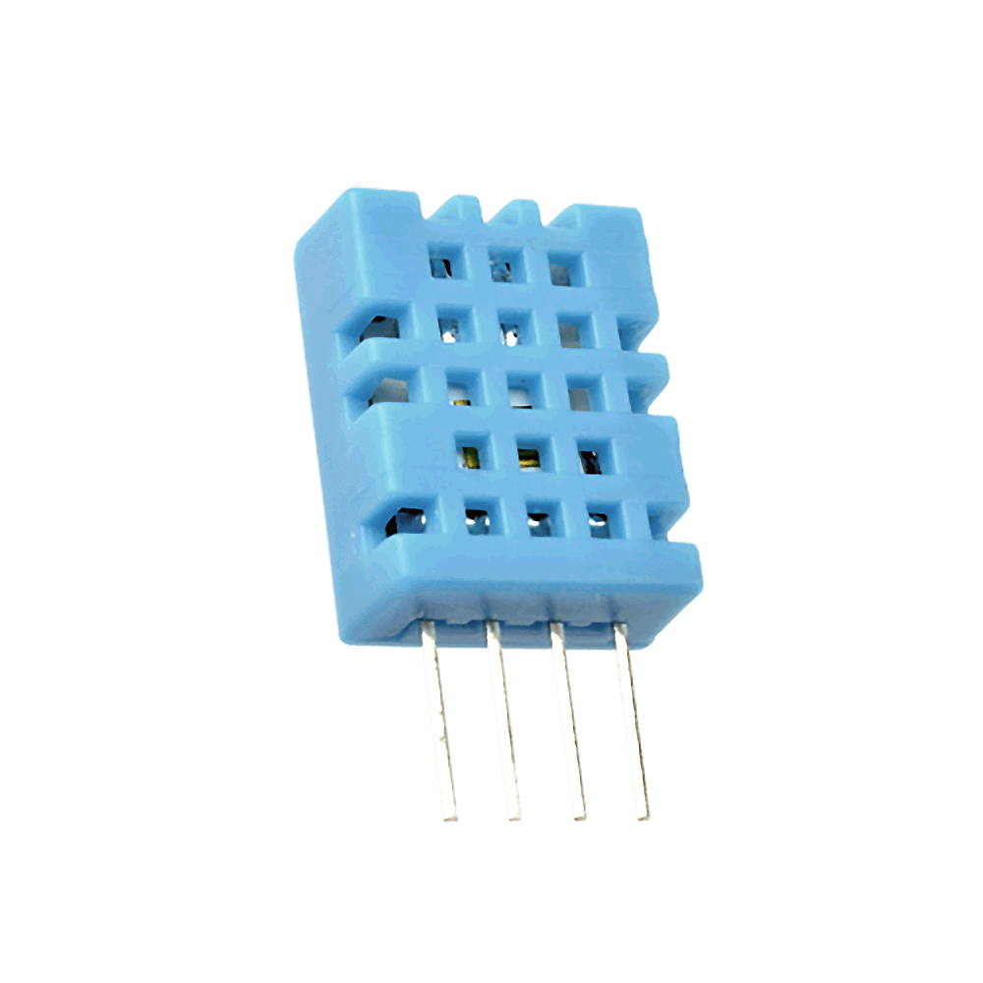

System Overview
Components: Sensors and Actuators, ESP32, Firebase, Mobile App.
Data Flow: Sensors → ESP32 → Firebase → Mobile App.
Functionality: Detect hazards, trigger alarms, and control actuators.

Slide 4
IOT Architecture Level
This system uses the IOT Architecture level-2
Data is stored in the cloud (Firebase)
Data is analyzed locally.
Rate of sensing is high (Temperature, humidity, flame detection status and gas level detection every 1000ms (1 second)).
Monitoring and control actions are done using a mobile application.

Slide 5
Data Storage and Management
Firebase: Real-time database for instant data syncing.
Stores sensor data and actuator status.
Enables mobile app to fetch and display data quickly.

Slide 6
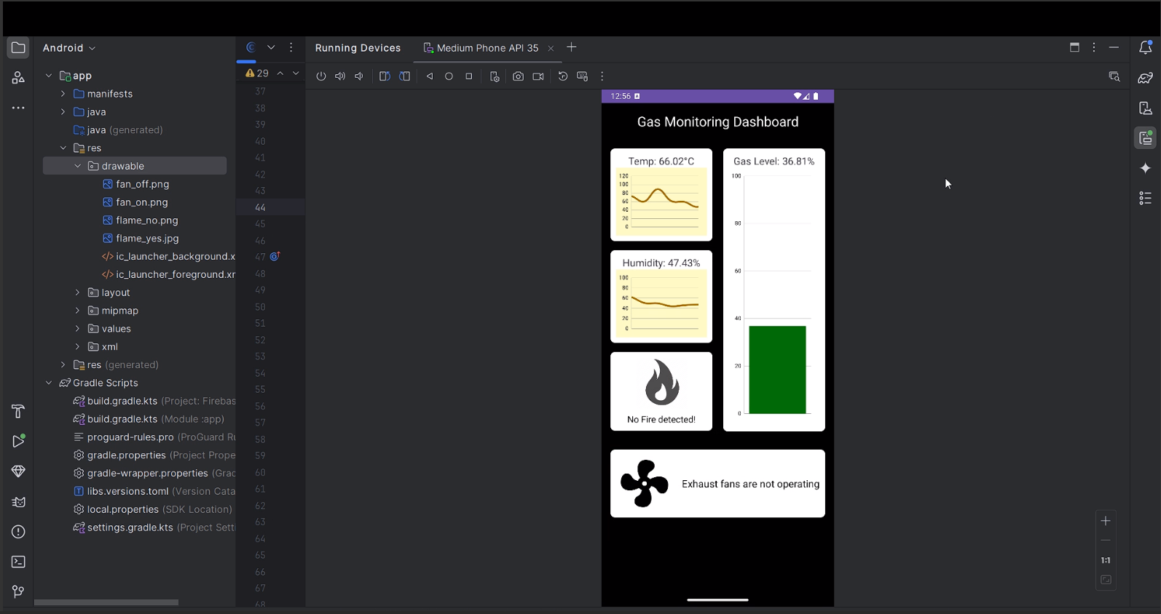


Mobile Application
Developed with Android Studio.
Features: Real-time data display, control panel, notifications.

Slide 7
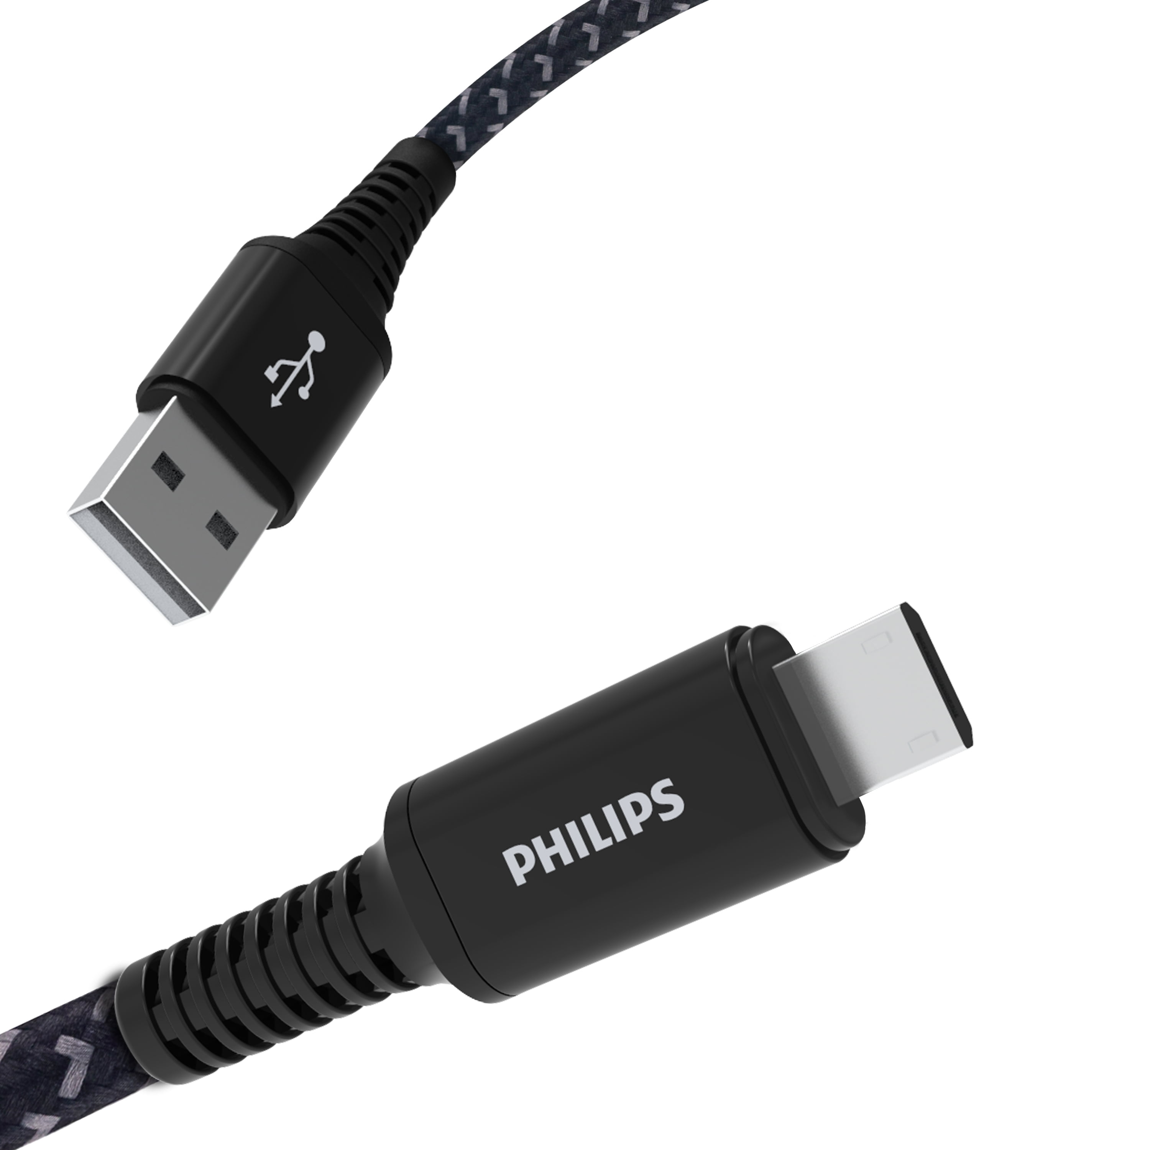

Power Source
For the project, we used the Micro-USB cable to provide power to the ESP32 board from the laptop.
Warehouse systems and equipment are powered by power grids as continuous power is required.
Reason for not using batteries is because continuous power supply is not provided.
Systems providing continuous monitoring functionalities always require constant power supply.

Slide 8

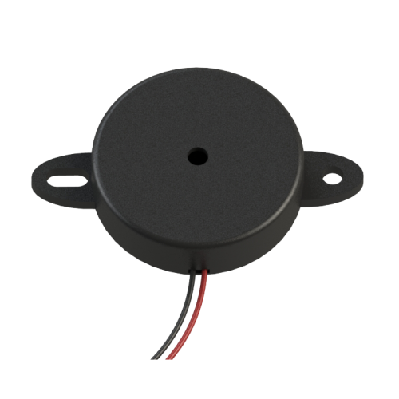
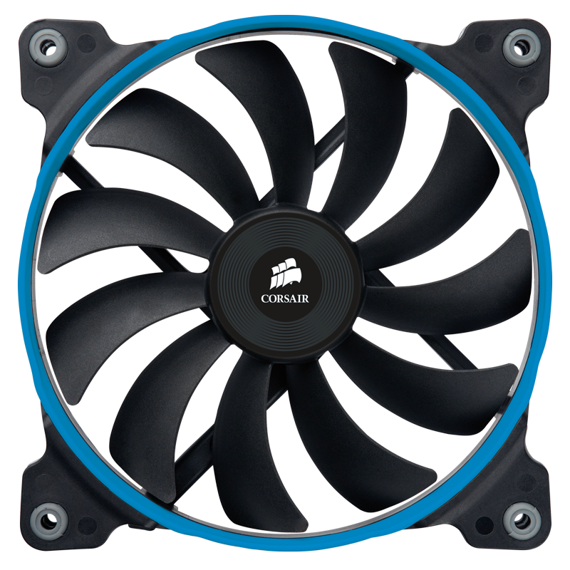
Sensors used
Flame Detection Sensor: Detects open flames, triggers safety actions.
MQ-2 Sensor: Detects combustible gases (e.g., LPG, smoke), alerts for leaks.
DHT11 Sensor: Measures temperature and humidity, monitors conditions.

Slide 9
Actuators used
Fans: Ventilate space when gas levels are high.
Buzzer: Alerts occupants during emergencies.
LED: Provides visual alerts on system status (safe, warning, danger).

Slide 10
Development Board
ESP32: Cost-effective, Wi-Fi/Bluetooth, powerful processing.
Role: Collects sensor data, processes it, and communicates with Firebase.

Slide 11
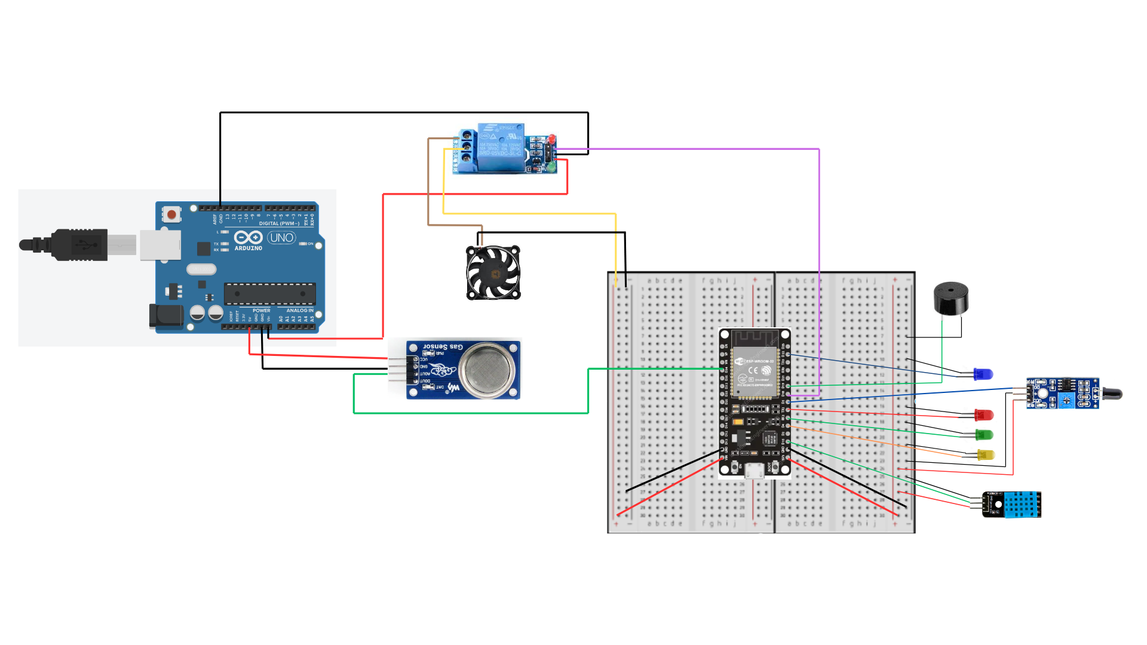
Wiring Diagram

Slide 12



Safety Mechanisms
Automated Responses: Fans and buzzers activated based on sensor thresholds.
Mobile app will also trigger an alarm whenever sensor values go beyond thresholds.

Slide 13


Benefits and Impact
Enhanced Safety: Reduces risks of gas leaks and fires.
Efficiency: Continuous monitoring with automated responses.
Scalability: Expandable to larger facilities or additional sensor types.

Slide 14

Challenges and Solutions
Challenges: Connection with firebase, sensor calibration, ESP32 not providing sufficient power to provide to all sensors
Solutions: Provided better network configurations to ESP32, mapped sensor values to match better readings, external power source (from Arduino).

Slide 15
Future Enhancements
Additional Sensors: Additional MQ-series sensors to detect more gas variations, security features like keypads for secure entry access to the warehouse, 180-degree angled flame detection sensors.
Manual Configuration of threshold values: Allow authenticated users to the Firebase DB to manually configure threshold values when required.

Slide 16

Video Demonstration

Slide 17
Conclusion
Recap project purpose and key components.
Emphasize safety improvements and innovation.
Highlight future potential for system expansion and enhancement.

Slide 18

Thank You

